Slide 1

How Does Cyclistic Navigate Speedy Success?
PRESENTED BY:
Jacob Freed
Last updated: June 2nd, 2023

Slide 2
Table of Contents
Overview
The Story The Analysis Tells Us
Conclusions and Where We Go From Here

Slide 3
Overview

Slide 4
Overview
We will answer how the two types of Cyclistic customers, the annual members and casual riders use their rented bikes differently.
We have analyzed the provided year-to-date data to reach the following conclusions.

Slide 5
The story the analysis tells us

Slide 6
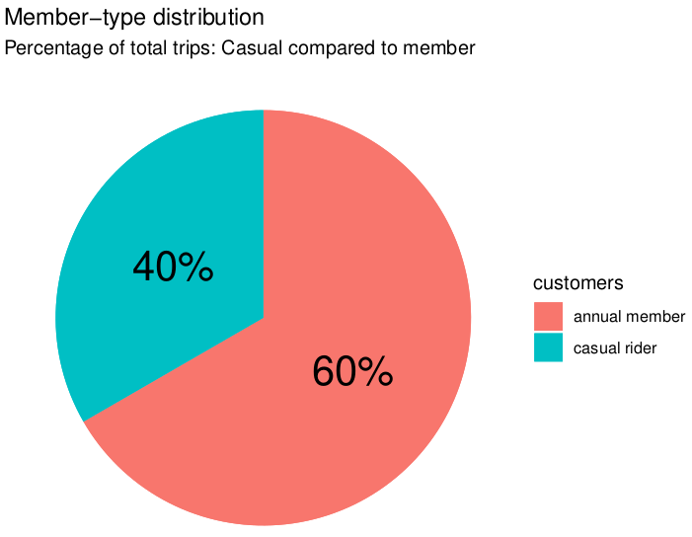
Distribution of Customer Trips
Annual members made up 60% of the trips.
Casual riders made up 40% of the trips.

Slide 7
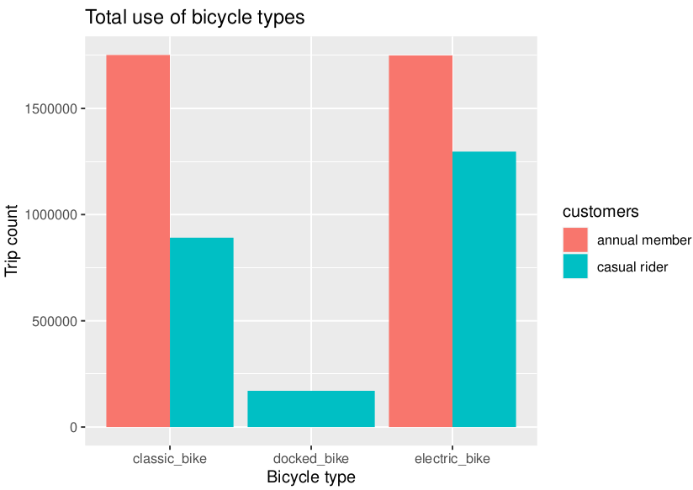
Total Bike Use by Trips
Electric bikes are more popular for the casual riders.
Annual member have roughly parity between classic and electric bicycle use.
Docked bicycles are only used by casual riders.

Slide 8
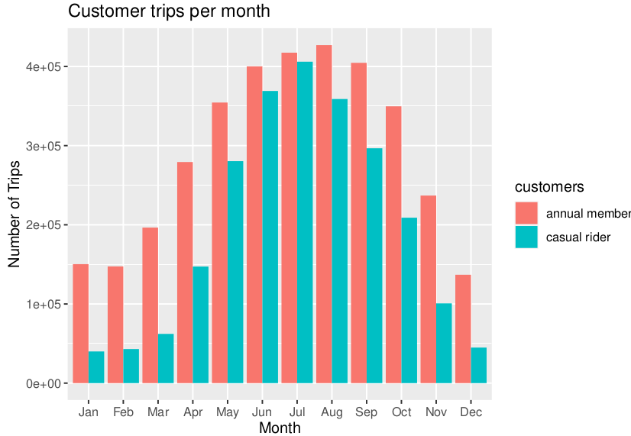
Trip Distribution by Month
Winter months (November to February) see a major drop in usage for both customer types and summer months (May to September) feature a spike in the bikes' use, almost to parity for June and July.
The winter months' effect is particularly pronounced for the casual riders. Annual member use peaks in August, as compared to July for casuals.

Slide 9
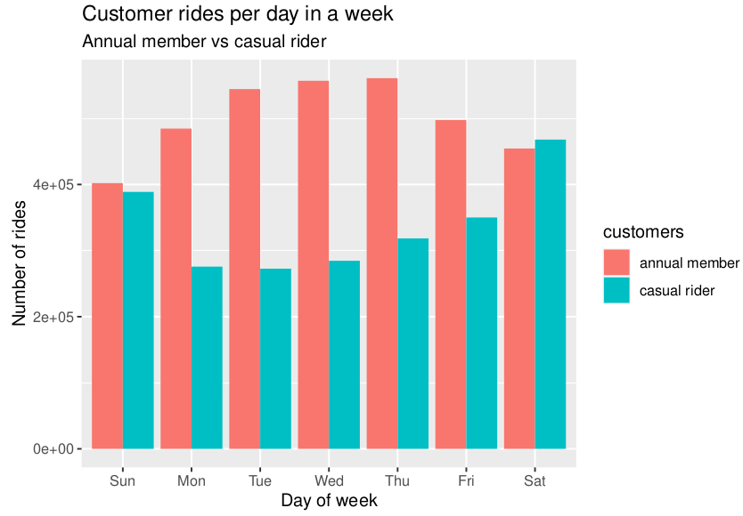
Weekly Distribution of Rides
The distribution of the hourly data for annual member trips implies they generally ride to and from work on the weekdays, a fact which hints that they are likely to be Chicago residents.
Prime time for casual riders is the weekend, with a falloff in the middle of the week.

Slide 10
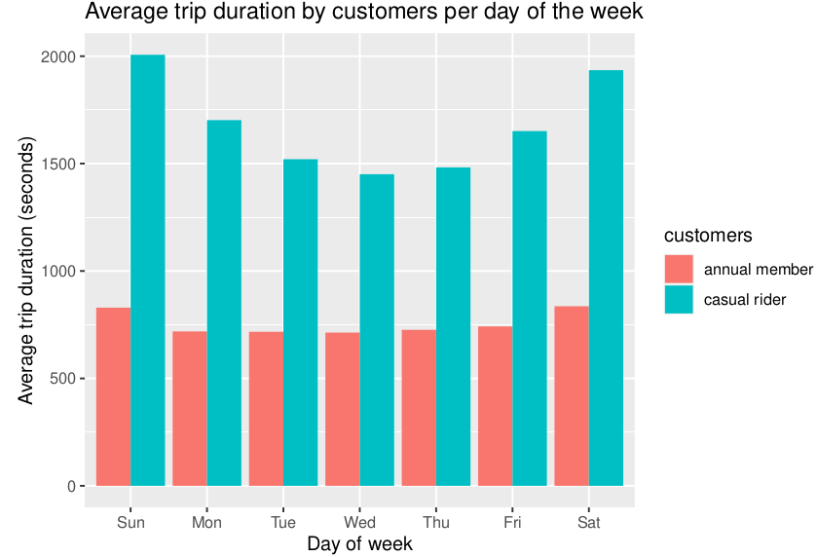
Average Trip Duration for Days of The Week
Casual riders have a greatly higher average trip duration than their annual member trip duration, but decrease noticeably towards the middle of the week.
Annual member trip durations stay roughly the same across all days.

Slide 11
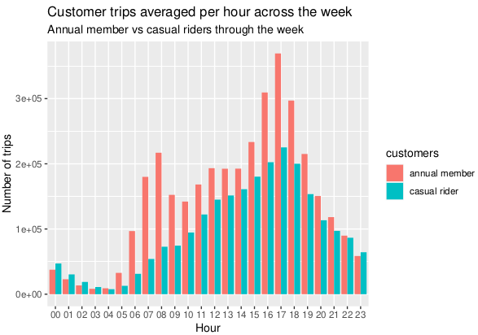
Customer Trips Averaged Per Hour for The Week
Member riders have two peaks in usage clustered around 8 AM and 5 PM, implying departing to and returning from work.
Casual riders have only one peak around 5 PM.

Slide 12
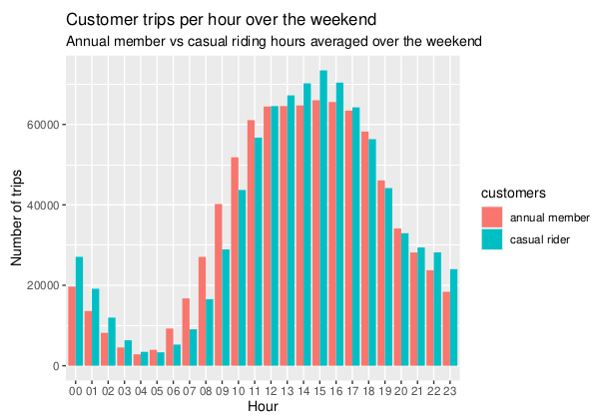
Customer Trips Averaged Per Hour for The Weekend
Casual trips are concentrated during 9 AM to 7 PM during the weekends, exceeding annual member trip durations at the peak.

Slide 13
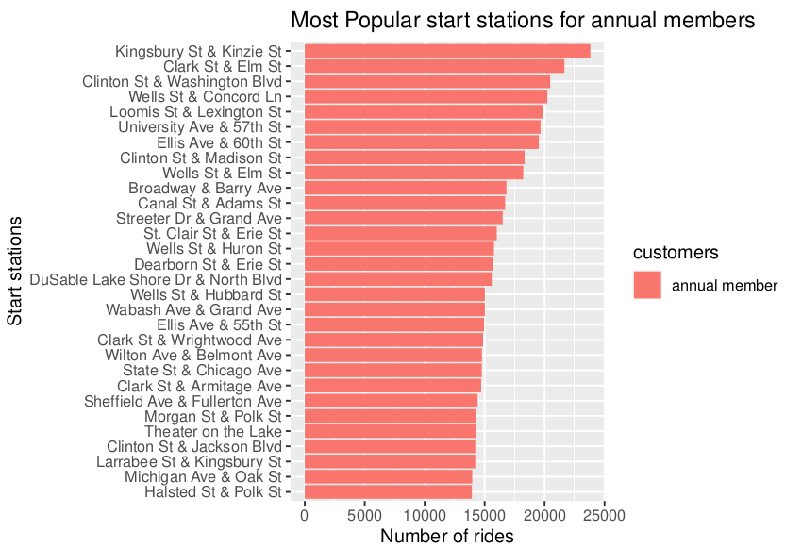
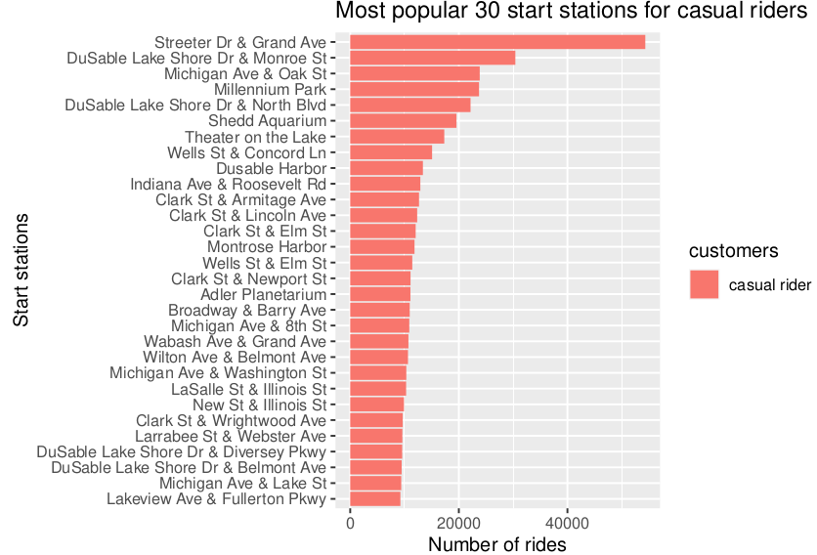
Most Popular Customer Starting Stations
Kingsbury Street and Kinzie Street is the most popular departure station for annual members.
Streeter Drive and Grand Avenue is the most popular starting station for the casual riders, more than twice as popular as the second most station.
There is a lot of overlap of these top-utilized stations, 12 are shared.

Slide 14
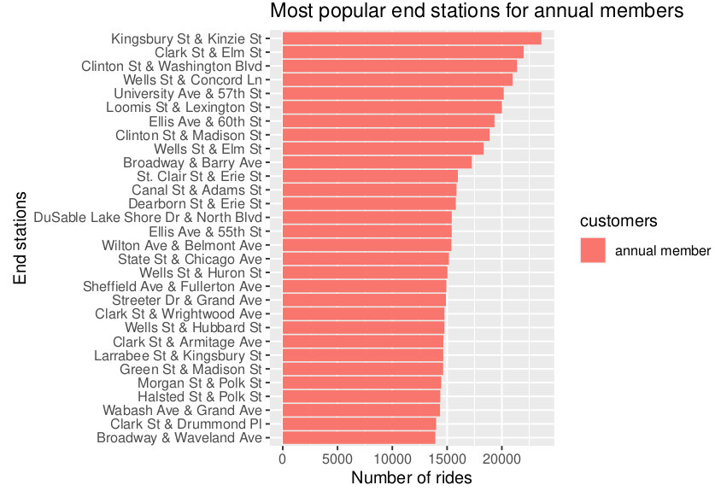
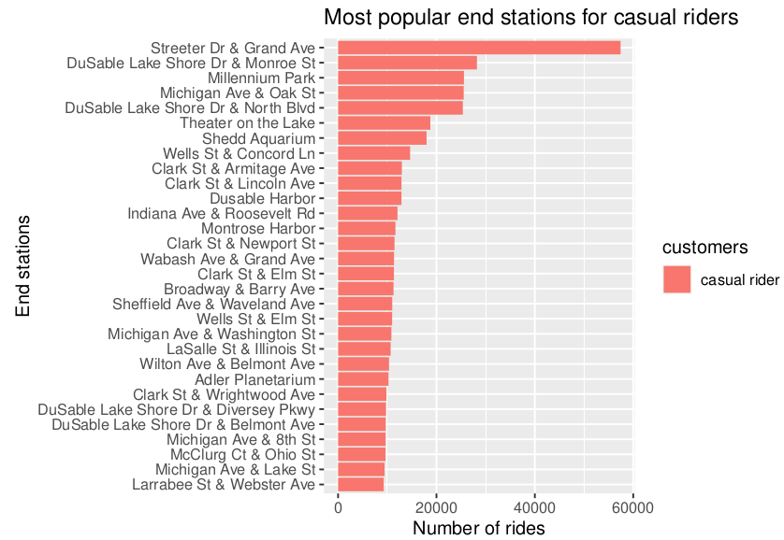
Most Popular Customer Ending Stations
Kingsbury Street and Kinzie Street also the most popular ending station for annual members. Much of the ending stations are also start stations, implying consistent routes.
Streeter Drive and Grand Avenue is the most popular finishing station for the casual riders, likewise more than twice as popular as the second most station.

Slide 15
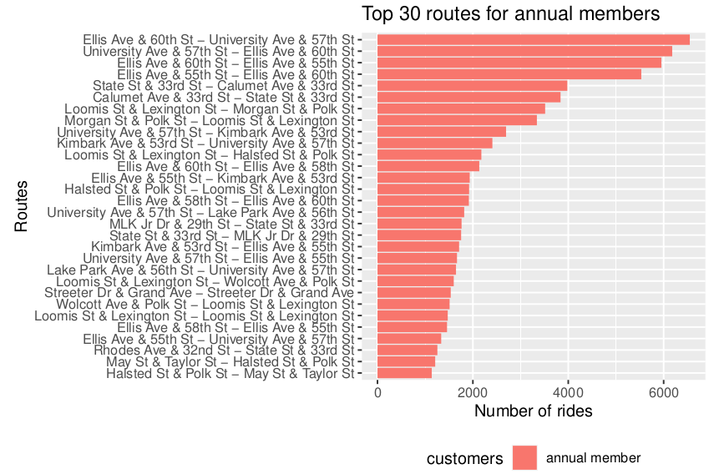
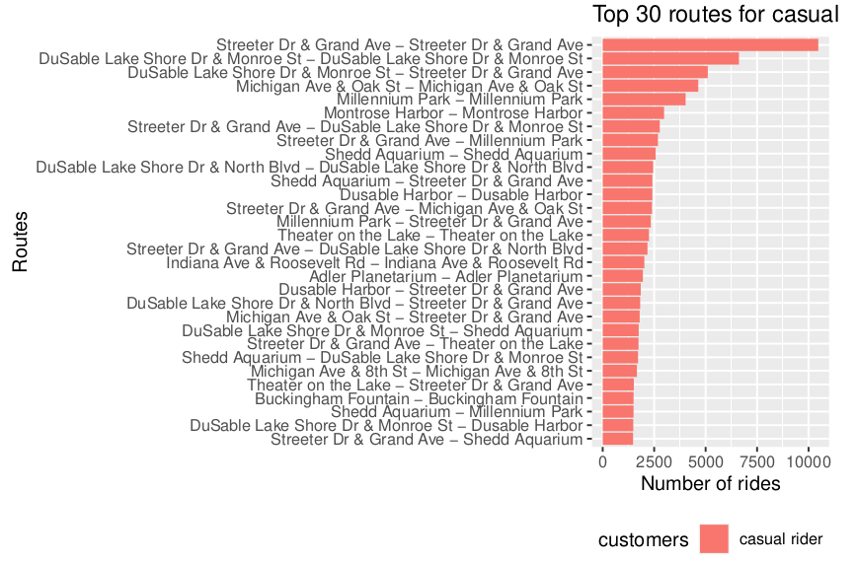
Most Popular Customer Routes
Ellis Avenue and 60th street to University Avenue and 57th Street proved to be the most popular route for annual member riders.
Streeter Drive and Grand Avenue to looping back to itself was the most popular route for casual riders by a large margin. This implies round-trip touring.

Slide 16
Conclusions and Where We Go From Here

Slide 17
Findings
My analysis turned up the following points from the data:
60% of the total trips during this time range were done by annual members, the remaining 40% by casual riders.
Electric bikes are more popular than their classic counter parts for casuals, but roughly equal in popularity for members. A side note, only the casuals used the docked bikes and then only a minority of them.
Winter months (November to February) see a major drop in usage for both customer types and summer months (May to September) feature a spike in the bikes’ use, almost to parity for June and July. The winter months’ effect is particularly pronounced for the casual riders. Annual member use peaks in August, as compared to July for casuals.
The distribution of the hourly data for annual member trips implies they generally ride to and from work on the weekdays, a fact which hints that they are likely to be Chicago residents.
Annual members started the most trips of any station at Kingsbury Street & Kinzie Street while the casual riders began more trips at Streeter Drive & Grand Avenue.
The top 4 routes for annual members and casual riders are a large chunk of the total for each, particularly casual rider’s top route. The higher average trip duration for members implies they travel farther than their casual counterparts.

Slide 18
Recommendations
Based on this analysis, I can think of a few improvements to get more out of future endeavors:
Deeper customer data collection would yield more potential insights, collect characteristics such as age, gender, residence, and other relevant factors to better understanding of their needs.
Ensure the incoming data has all of the variables, such as start and end stations being present, proper time accounting and station IDs.
Identify residents who are casual riders to launch a better targeted advertisement campaign.

Slide 19
Questions?
CONTACT:
jdf009@yahoo.com

